Slide 1
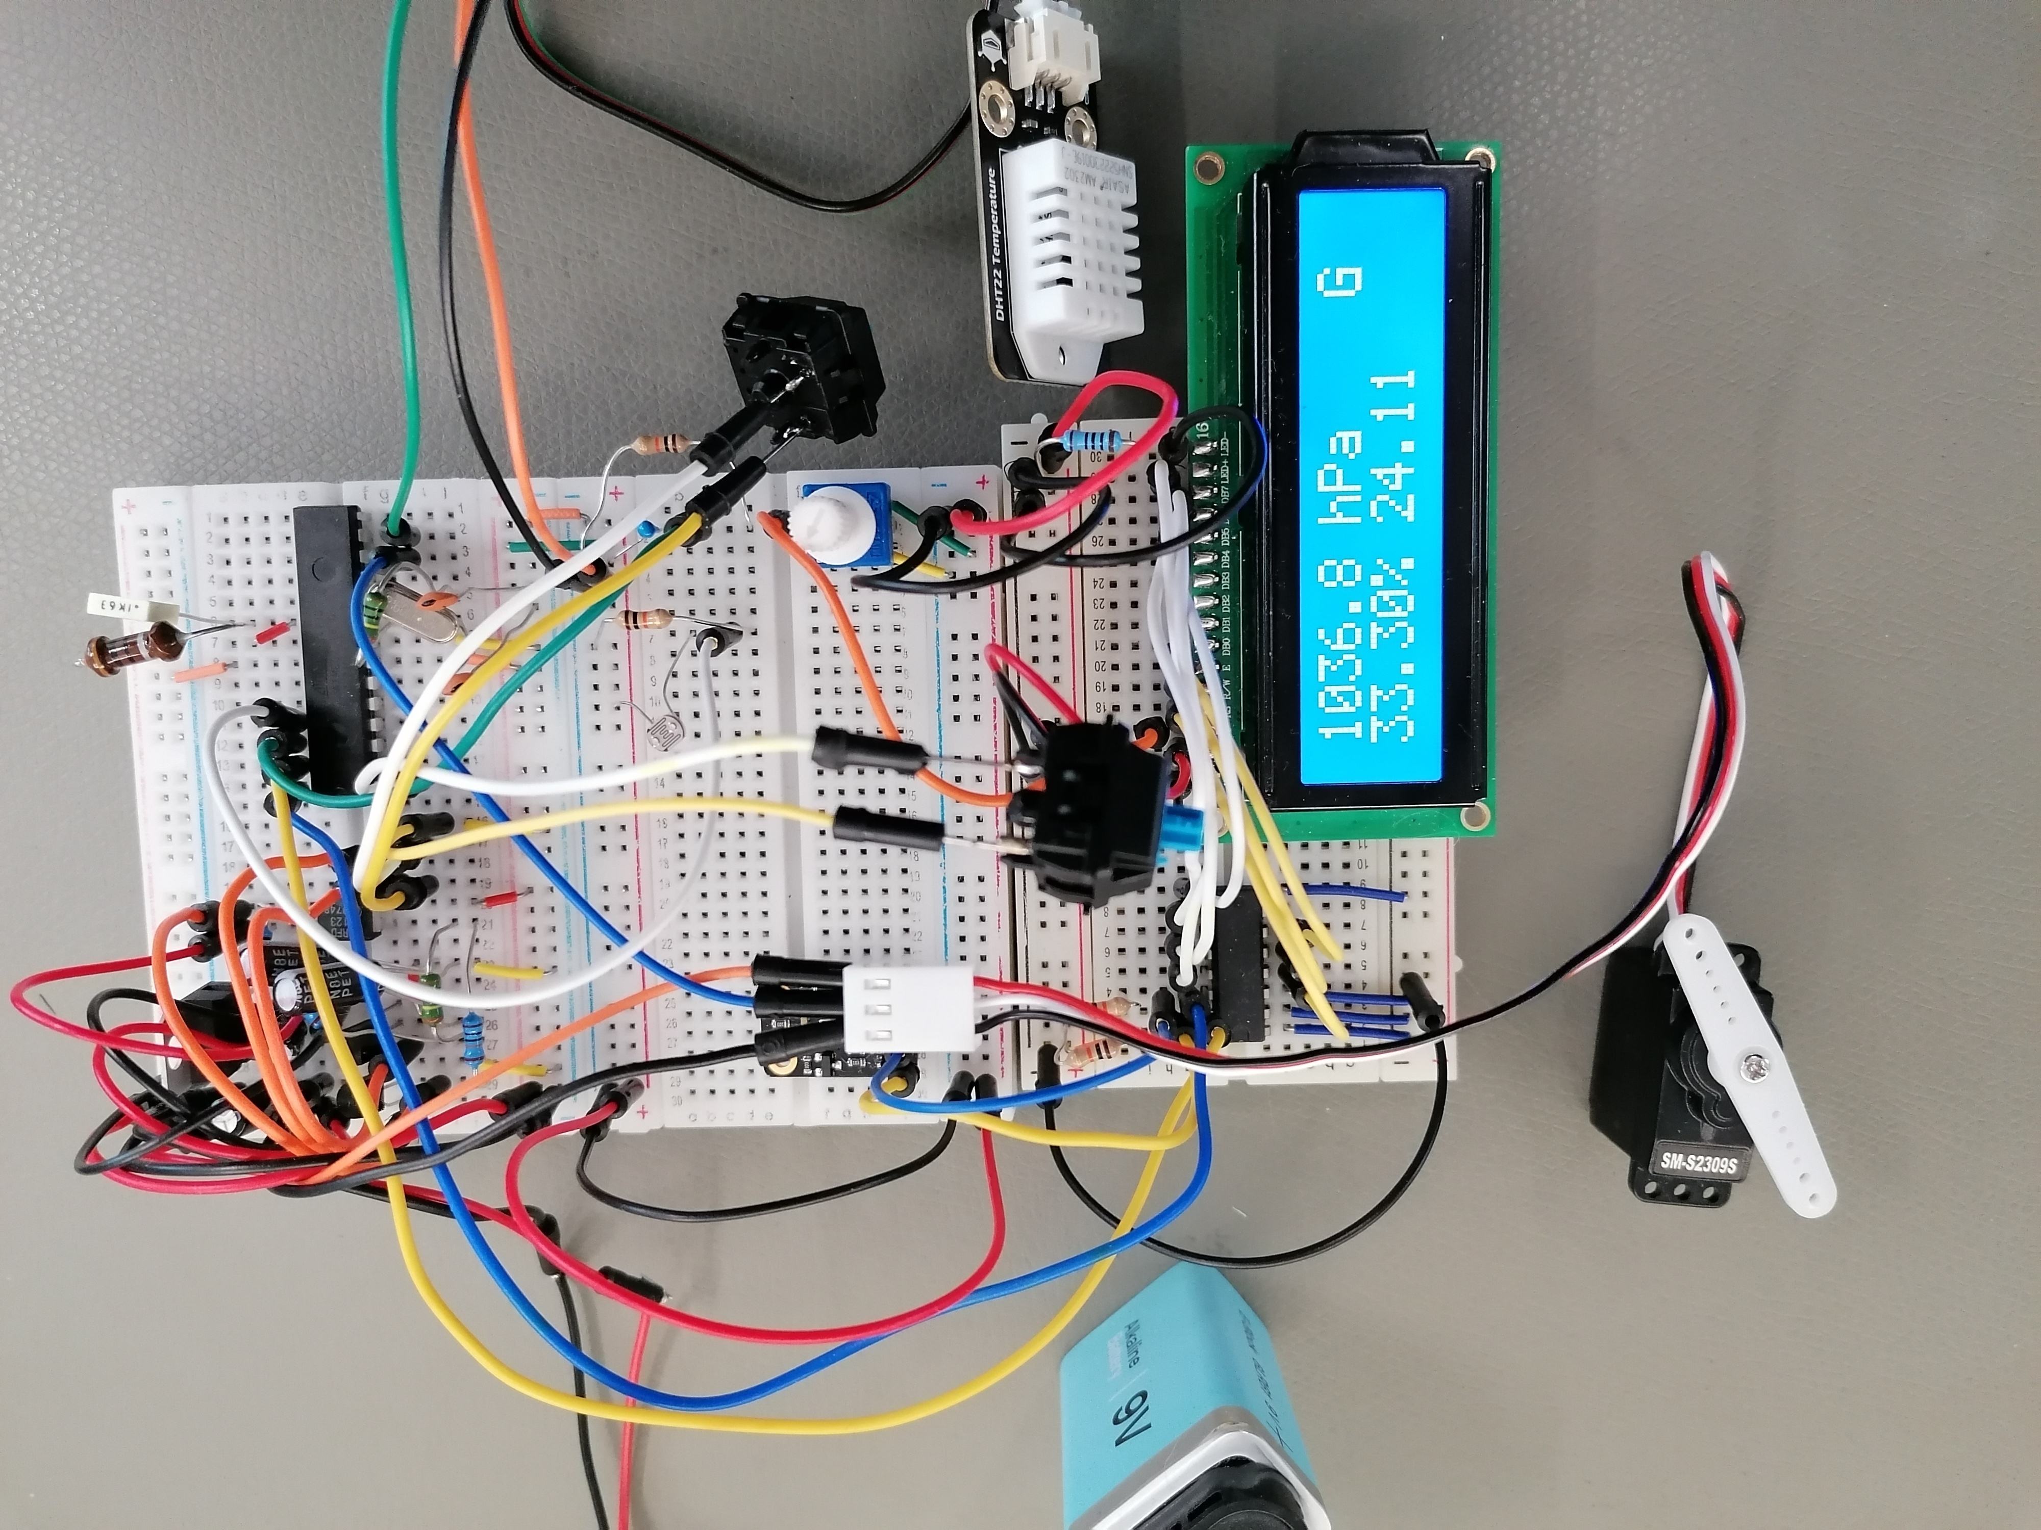
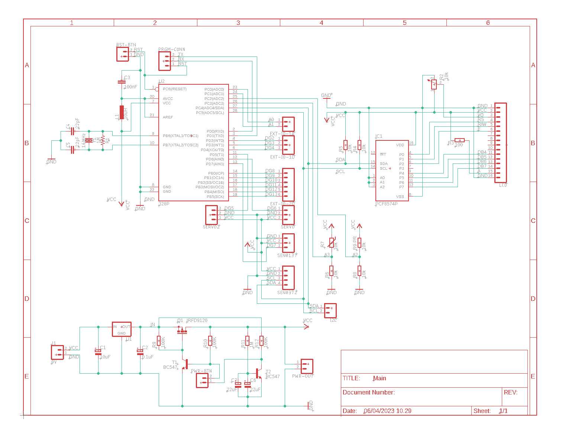
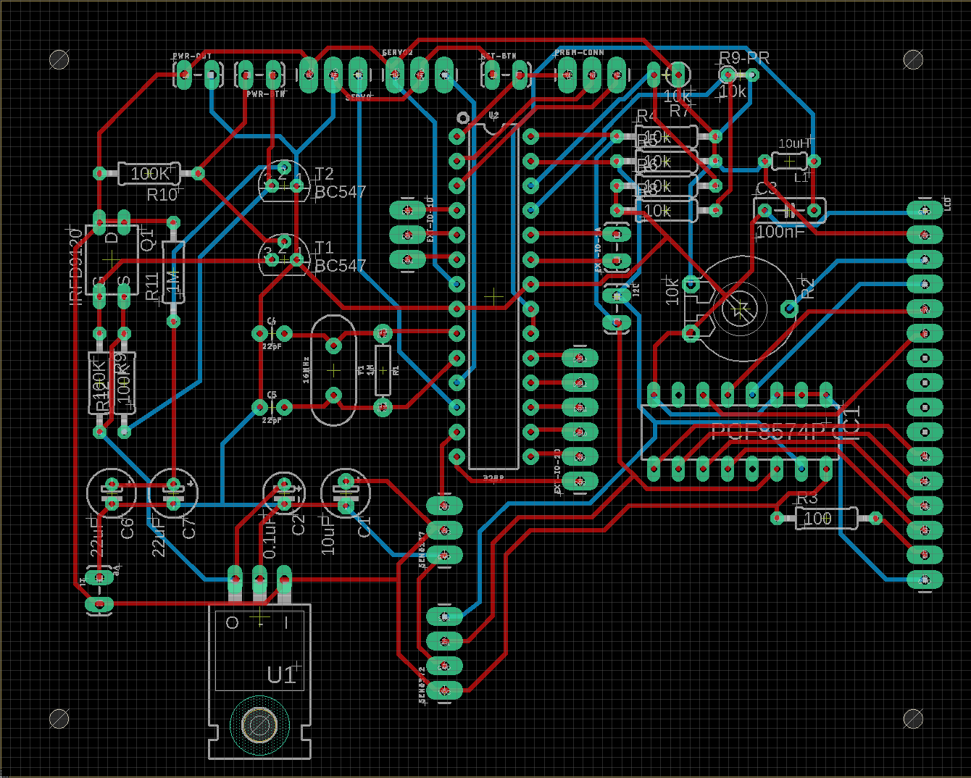
Indoor Climate Monitor
Venni Karhukorpi, Juho Laurila,TVT21SPL
Information Technology, Option of Device and Product design
Introduction
The Indoor Climate Monitor is a sophisticated device designed to measure and monitor various indoor environmental factors, including relative humidity, temperature, barometric pressure, and the amount of light in the room. This project aims to design and implement an indoor climate monitoring system using an ATmega328P microcontroller and multiple sensors as shown in the figure 1 below, providing real-time data on indoor environmental factors for users to optimize their indoor environment for comfort and productivity.
FIGURE 1. The schematic showing the implementation
Objectives
To design a cost-effective and reliable indoor climate monitoring system
To interface multiple sensors with the ATmega328P microcontroller for accurate data acquisition
To develop a user-friendly interface for data visualization and analysis
To conduct experiments to evaluate the performance of the system
Methods
The Indoor Climate Monitor uses an ATmega328P microcontroller to interface with multiple sensors, including the DHT22 sensor for temperature and humidity, the thermistor for temperature, the SEN0372 sensor for barometric pressure, and a photoresistor for measuring the amount of light in the room. The sensors are connected to the ATmega328P microcontroller through appropriate circuits. (See the figure 2 below.) The 16x2 LCD screen provides a user-friendly interface for displaying the real-time data. The system is powered through a LM7805 regulator to ensure stable and reliable power supply.
FIGURE 2. the Circuit diagram
Results
The Indoor Climate Monitor delivers accurate and reliable real-time data on indoor environmental factors, including temperature, humidity, barometric pressure, and light. The 16x2 LCD screen provides a user-friendly interface for displaying the data. (See the figure 3 below.)
FIGURE 3. Protype displaying the data
Conclusions
The Indoor Climate Monitor is the solution for monitoring indoor environmental factors. It provides real-time data, which can help users make informed decisions to create a comfortable and healthy indoor environment.
References
1. ATmega328 datasheet source:
https://ww1.microchip.com/downloads/en/DeviceDoc/ATmega48A-PA-88A-PA-168A-PA-328-P-DS-DS40002061B.pdf
2. PCF8547 datasheet source: https://www.ti.com/lit/ds/symlink/pcf8574.pdf
Electronics Application Project
ECTS credits: 15
Date of publication: 2023, Spring
Instructors: Harri Määttä, Olli Himanka, Sami Laine, Miisa Tanner

